Slide 1
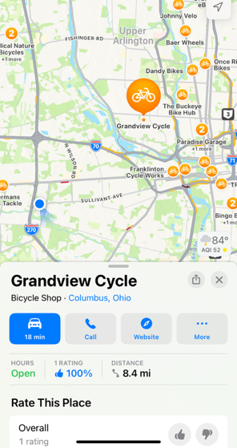
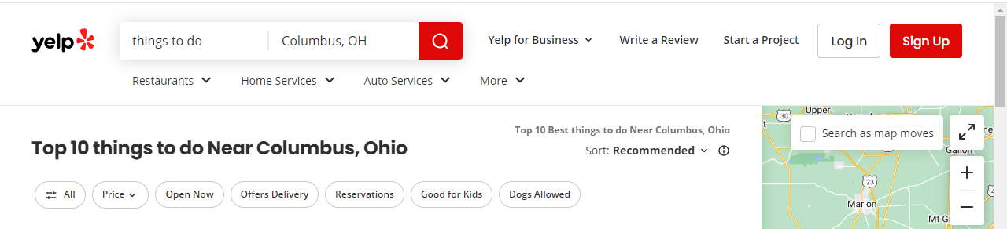
Team name..
Determined the project object: TripAdvisor-like app for querying ‘well known’ artists at travel destinations
Decided on artform, initially was painters and sculptors.
Determined the definition of ‘well-known’ or ‘popular’ art.
artwolf.com
ranker.com
mymodernmet.com
Located sources of art, i.e., museums
Each of us selected a region within the Midwest

Slide 2
Acquire data
ETL diagram
Museum
Project 3
End-user app
museums
Import: Iowa.csv,
MIA.csv,
Top101painters.csv,
Topsculpturists.csv
*.csv
a. Metadata
API call
Input: artfiltered.json
Beautiful Soup (module 11)
Iowa.ipynb
pgAdmin
PostgreSQL
(module 9)
artfiltered.sql
(module 14)
artfiltered.js
Flask
(module 11)
artfiltered.py
Output: Iowa.csv
Output:
ERD
artfiltered.csv
Output: artfiltered.json
Direct data entry
Top lists
A chicken crossing the road is poultry in motion.
Theartwolf

Slide 3
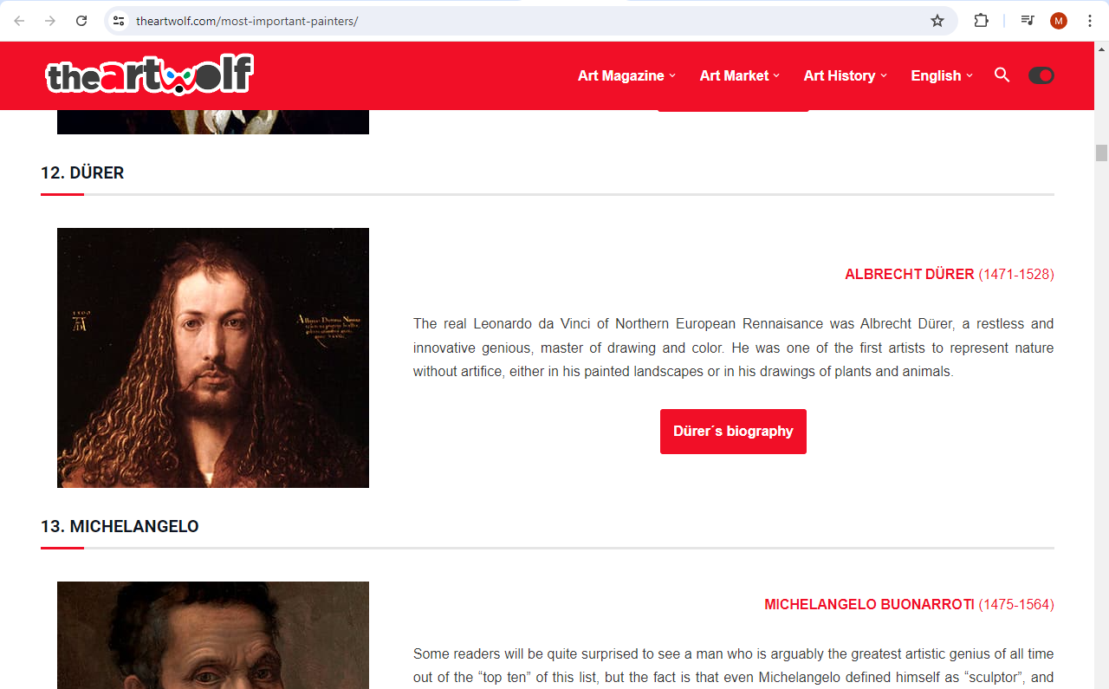
Top Lists
Artwolf.com
Splinter
Beautiful soup
Regular expressions
pandas – lots of data cleaning, merging df, etc.
Pandas
ranker.com
mymodernmet.com
Output was .csv file that was passed to each museum
Yes, this is subjective, but could also be educational
The hardness of the butter is proportional to the softness of the bread.

Slide 4
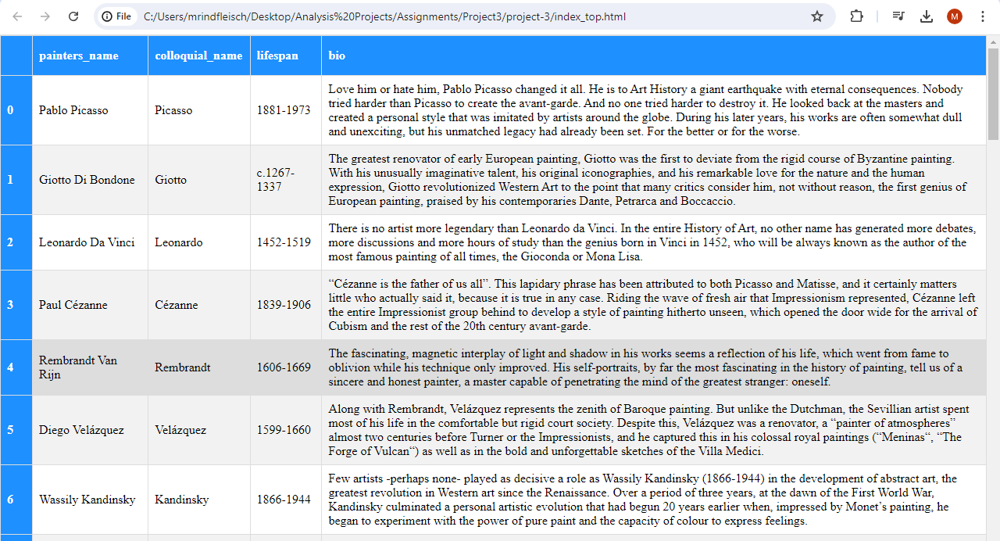
Top Lists
An html file was crafted:
Becoming vegetarian was a huge missed steak.

Slide 5
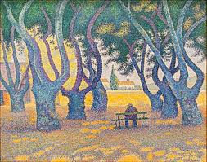
Carnegie Museum of Art
Source: json file via GitHub, ~28,000 works of art
reduced data to 4 different art forms, -16,000 works
jupyter notebook:
json module
pandas – for loops, data cleaning
Regular expressions
Output: .csv, uploaded in PostgreSQL
Had to clean more, use “|” not “,”
Filter using sql code
using many-to-one relationship (ERD)
Created query (View)
250 pieces of art at Carnegie by “top artists”
If you take your laptop for a run, you jog your memory.

Slide 6
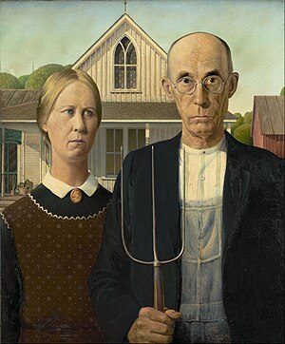
Chicago Institute of Art
Source: data dump from GitHub
Museum discouraged scraping of website
Took over 5 hours to unzip because each piece of art had several json files
Imported data in Pandas jupyter
Filtered on artist: Reduced file to just under 4000 records
Iterated through the json files to get rest of the data
Saved as CSV file to download to database
Santa's helpers are subordinate clauses.

Slide 7
Code Snippet to extract data from 4000 files
def extract_date_display(row):
id = row['id']
filename = f"{id}.json" #JSON files are named after the artwork id numbers
file_path = os.path.join(r'api-data\json\artworks', filename)
if os.path.exists(file_path):
with open(file_path) as json_file:
data = json.load(json_file)
date_display = data.get('date_display')
return date_display
else:
return None
# Add creation_date to dataframe
merged_df['creation_date'] =merged_df.apply(extract_date_display, axis=1)

Slide 8

Cleveland Museum of Art
Source: json data via GitHub, 78,000 records
Imported data in Pandas jupyter
Filtered on 4 different of art
Data cleaning
Went into sql
Ran into upload csv problems
Query reduced that to 250 records
A boiled egg in the morning is hard to beat.

Slide 9
Final output
Panda dataframe and csv.file of combined data from all three museums:
Postgres database ‘art’
Pretty formatting of large sets of data:
Creating of an html file
CSV convertor
3rd one ???
Another library?
Borrow money from pessimists – they don’t expect it back.

Slide 10
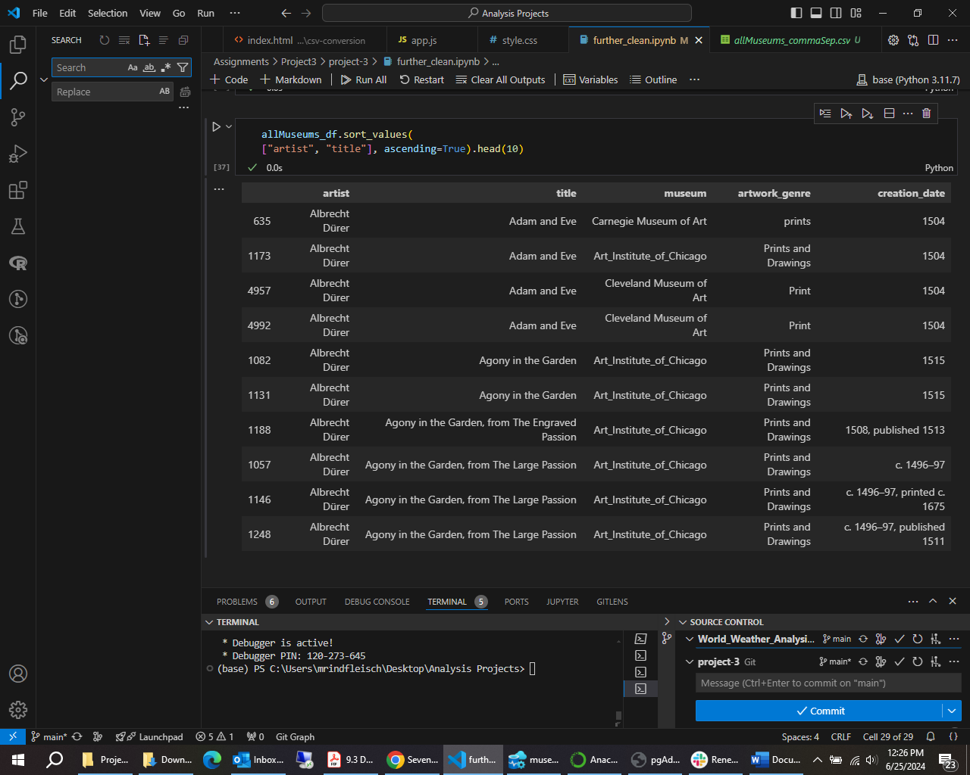

Slide 11
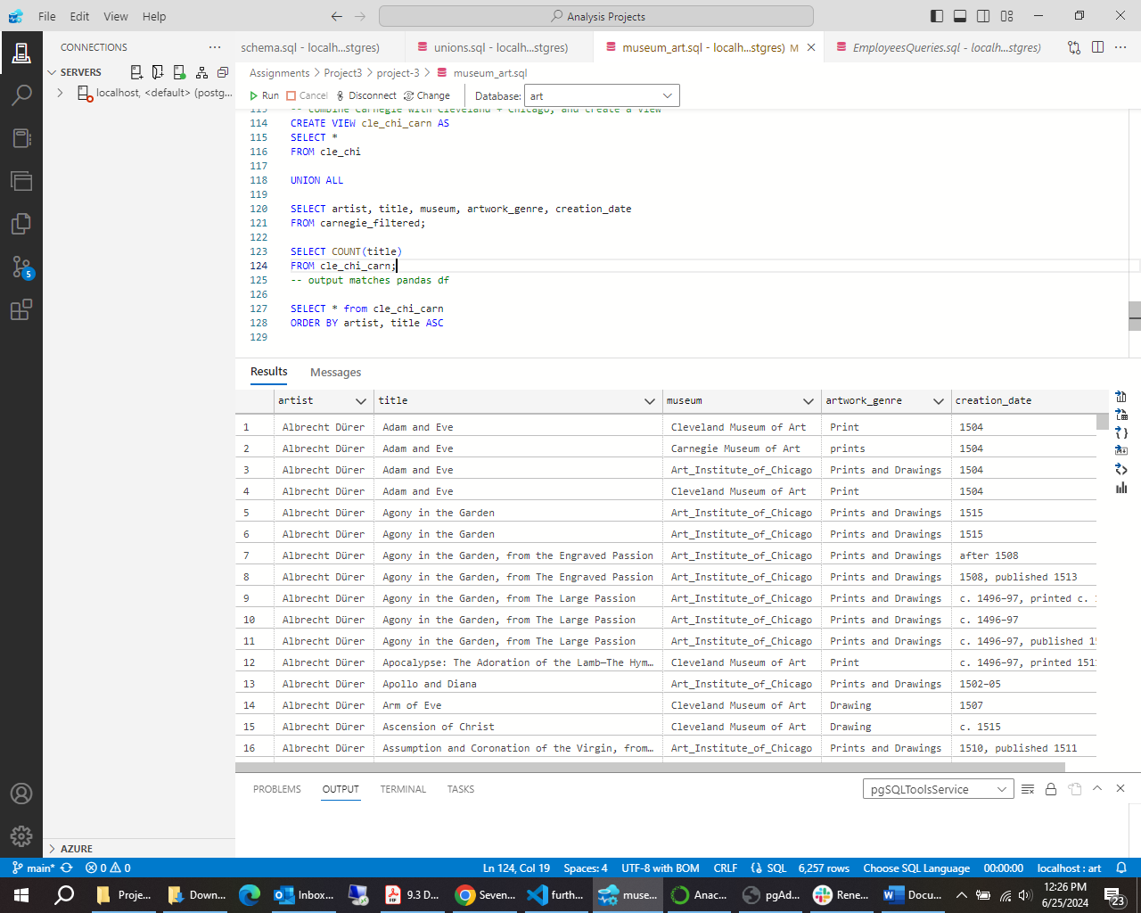

Slide 12
